Slide 1

SE DOMAIN PROJECT
MENTORING MANAGEMENT SYSTEM
PRESENTED BY:
S ASHOK KUMAR(211801340001)
K Bhanu Surya Prakash(211801340003)
Y NARAYANA RAO(211801340008)
P SAI VIKAS(211801340011)
G PAVAN KUMAR(211801340017)
P VISWASWARA RAO(211801340021)
GUIDED BY
R. Lakshmana Rao
Teaching Assistant
Department of Computer Science and Technology,
School of Engineering and Technology,
Centurion University of Technology and Management, Andhra Pradesh

Slide 2

GROUP MEMBERS PHOTO FRAME

Slide 3

TABLE OF CONTENTS
Introduction
Project Objective’s
Timeline
Literature Survey
Requirements
Block Diagram
Flow Chart
Next Review

Slide 4
INTRODUCTION
The mentoring management system aims to streamline the process of matching mentors with students and facilitating effective communication and tracking of progress within mentorship programs. This system will leverage technology to enhance the mentorship experience and optimize resource utilization.

Slide 5


PROJECT OBJECTIVES
Develop a user-friendly platform for mentor-student matching.
Implement features for communication, progress tracking, and feedback exchange.
Create a scalable system capable of handling multiple mentorship programs simultaneously.
Enhance mentorship program outcomes through analytics and reporting capabilities.

Slide 6

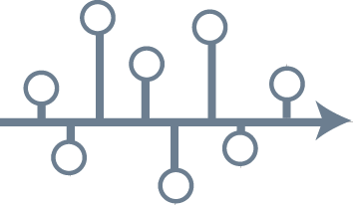
TIMELINE
Sl.NO | PROCEDURE | TIMELINE
1 | Requirements gathering and analysis | 15 Days
2 | System design and architecture development | 30 Days
3 | Implementation and testing | 30 Days
4 | Deployment and Implementation | 10 Days
5 | Maintenance and optimization | 10 Days

Slide 7

LITERATURE SURVEY
SL.NO | PAPER NAME | YEAR OF PUBLISHED | COUNTRY | PUBLISHER NAME | DOI NUMBER | KEYWORDS | OUR IDEA ABOUT THE PAPER
1 | A Survey of Blockchain based payment system. | 2018 | Switzerland | IEEE transactions on dependable & secure computing. | 10.1109/TDSC.2017.2789642 | Blockchain, Payment systems, Cryptocurrency. | To identify potential applications in EOD payments.
2 | Exploring scalability challenges | 2019 | Italy | IEEE Access | 10.1109/ACCESS.2019.2904055 | Scalability, Blockchain, Payment Systems. | Propose sol^ to enhance scalability.
3 | Towards a practical EOD payment using Cryptocurrencies. | 2018 | Germany | IEEE transactions on computer | 10.1109/TC.2017.2785847 | EOD payments, Cryptocurrencies, Feasibility. | Considering factors such as transaction throughput & latency.

Slide 8

LITERATURE SURVEY
4 | Design & implementation of a Cryptocurrency based on EOD payment system for financial; institutions. | 2020 | Germany | International conference on financial Cryptography & Data Security. | 101.1007/978-3-030-48757-3_1 | Cryptocurrency, financial institutions, Design & implementation. | Addressing regulatory compliance & scalability requirements.
5 | Secure & Efficient EOD payment system using Cryptocurrency & smart contracts | 2019 | Japan | IEEE Access | 10.1109/ACCESS.2019.2937694 | Smart Contracts, Cryptocurrency, Security. | Automating security settlements processes while ensuring security.
6 | Scalability of Blockchain based EOD payment systems : A performance Evaluation | 2018 | Italy | IEEE transactions on services computing | 10.1109/TSC.2017.2762887 | Scalability, Blockchain, performance Evaluation | Analyzing transaction throughput & latency.
7 | Decentralized EOD payment system using permissioned Blockchain | 2021 | Australia | ACM Transactions on internet technology | 10.1145/3439393 | Permissioned blockchain, Decentralization, payment systems | Addressing privacy & scalability concerns.

Slide 9
LITERATURE SURVEY
8 | An Empirical analysis of EOD payment systems using Cryptocurrencies | 2020 | Greece | Journal of Information Security and Applications | 10.1016/j.jisa.2019.102389 | Empirical Analysis, Cryptocurrencies, End-of-Day Payments | Settlement times, and reliability.
9 | Blockchain based EOD payment system for small & medium Enterprises | 2019 | US | International Journal of Advanced Computer Science and Applications | 10.14569/IJACSA.2019.0100596 | SMEs, Blockchain, Payment Systems | Enhancing efficiency and reducing costs.
10 | Enhancing EOD payment systems with blockchain technology | 2017 | Netherlands | International Conference on Financial Cryptography and Data Security | 10.1007/978-3-319-70278-0_9 | Blockchain, Payment Systems, Enhancement | Improving transparency, security, and efficiency.

Slide 10

REQUIREMENTS
Software Requirements:
User Management: Registration, login, and profile management for mentors and students.
Matching Algorithm: Development of an algorithm to match mentors with students based on compatibility criteria.
Communication Tools: Messaging system, scheduling features.
Progress Tracking: Tracking progress, and exchanging feedback.
Analytics and Reporting: Generation of reports on mentorship program performance and outcomes.

Slide 11
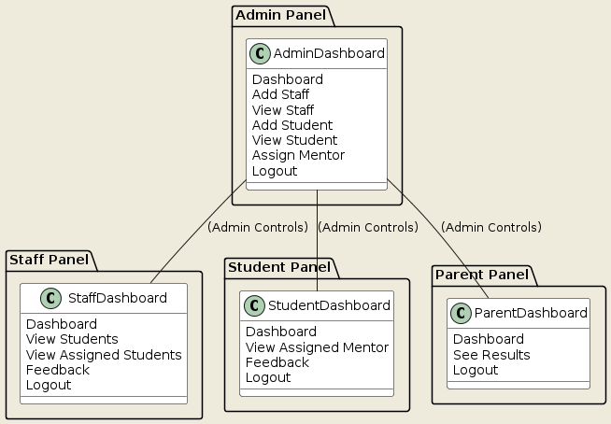
BLOCK DIAGRAM
→
→
→
→
→

Slide 12
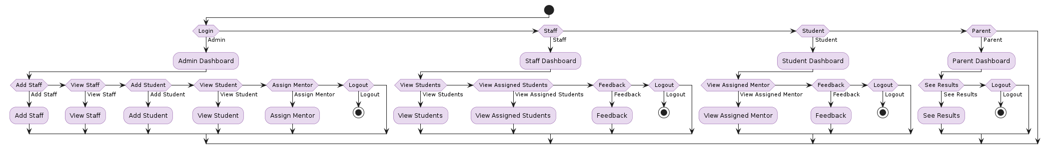
FLOW CHART
→
→
→
→
→
→
→

Slide 13
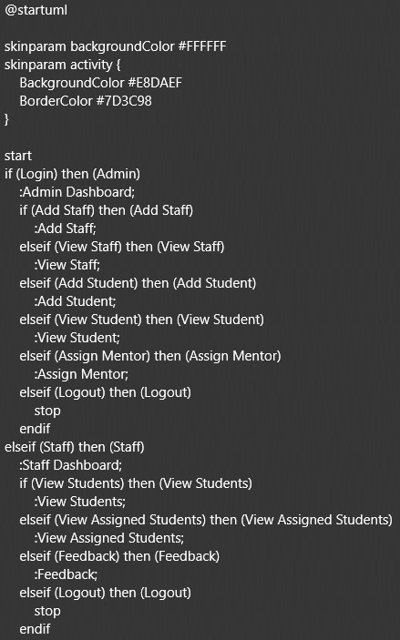
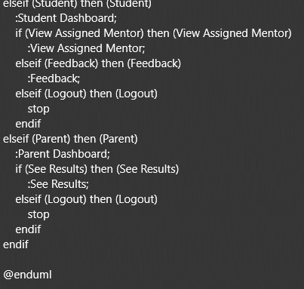
IMPLEMENTATION
.
→
→
→
→
→
→
→

Slide 14
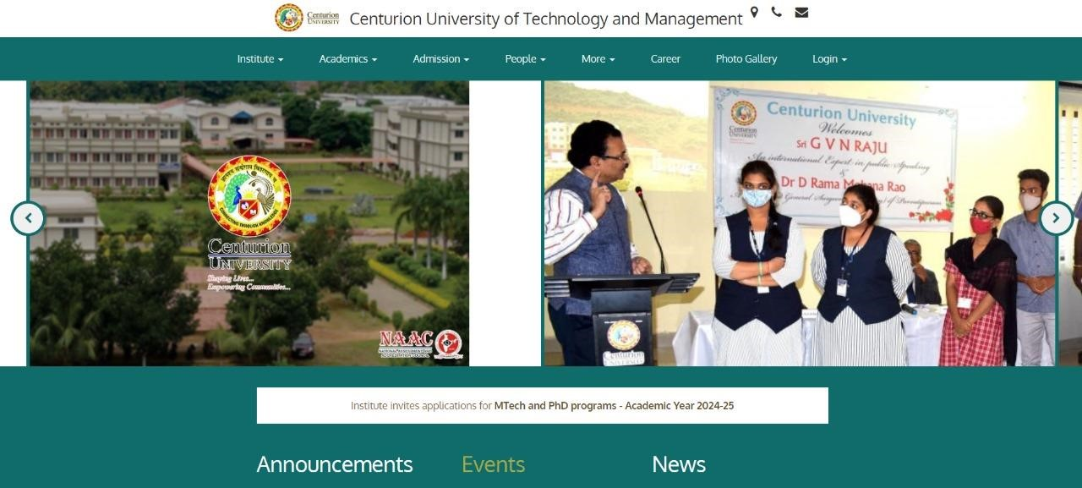
RESULTS OR OUTPUTS
→
→
→
→
→
→
→

Slide 15
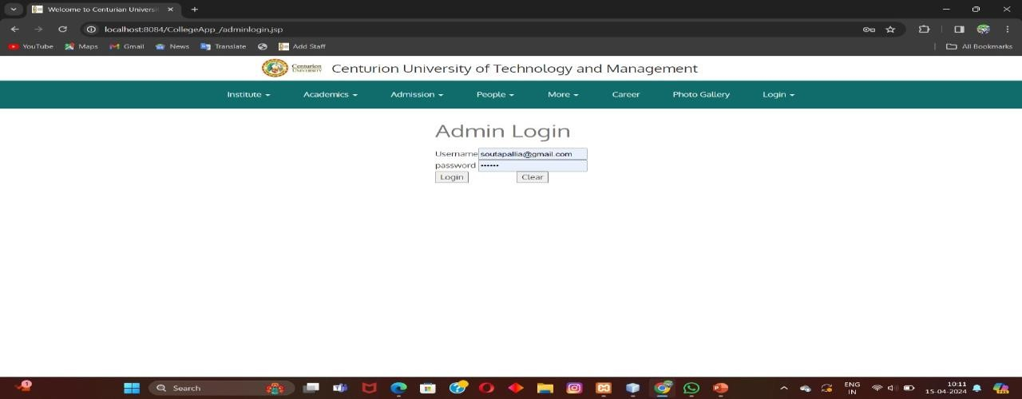
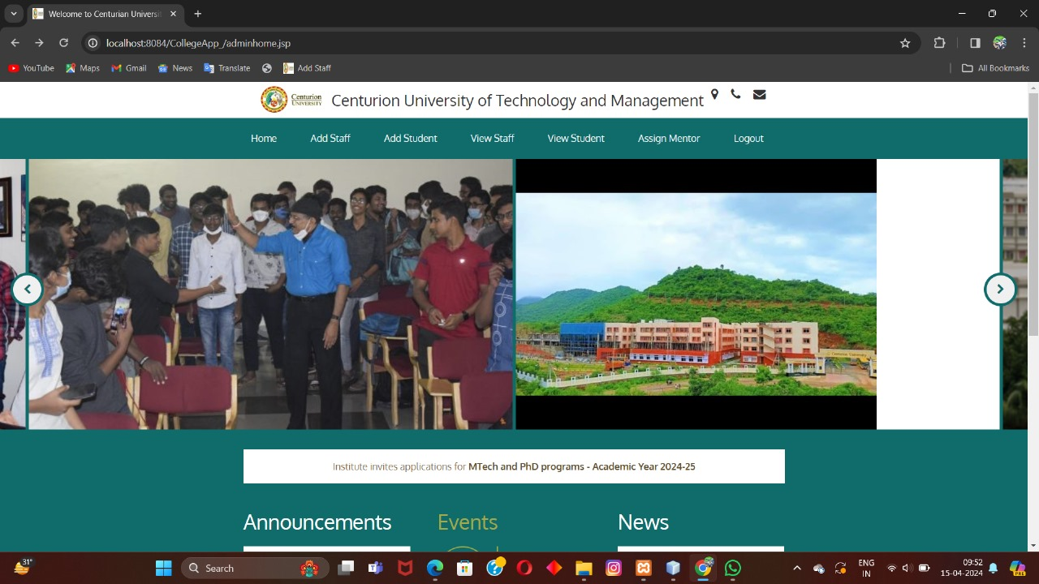
RESULTS OR OUTPUTS
ADMIN PAGE
→
→
→
→
→
→
→

Slide 16
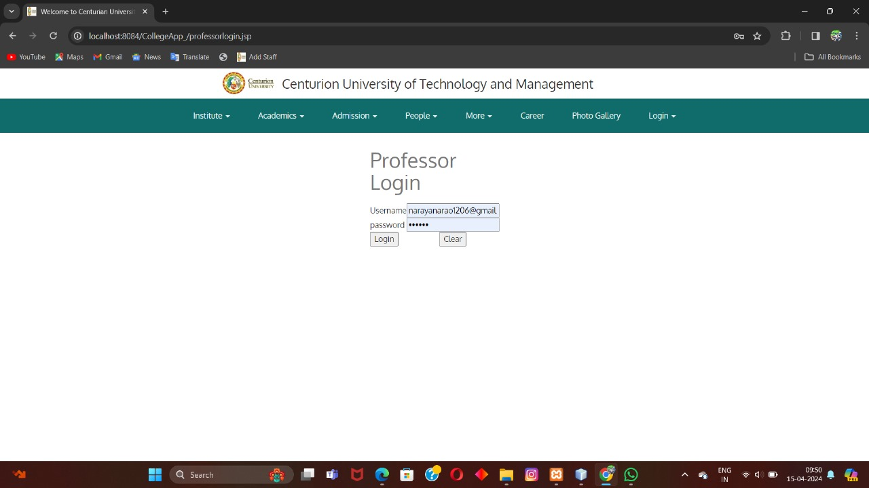
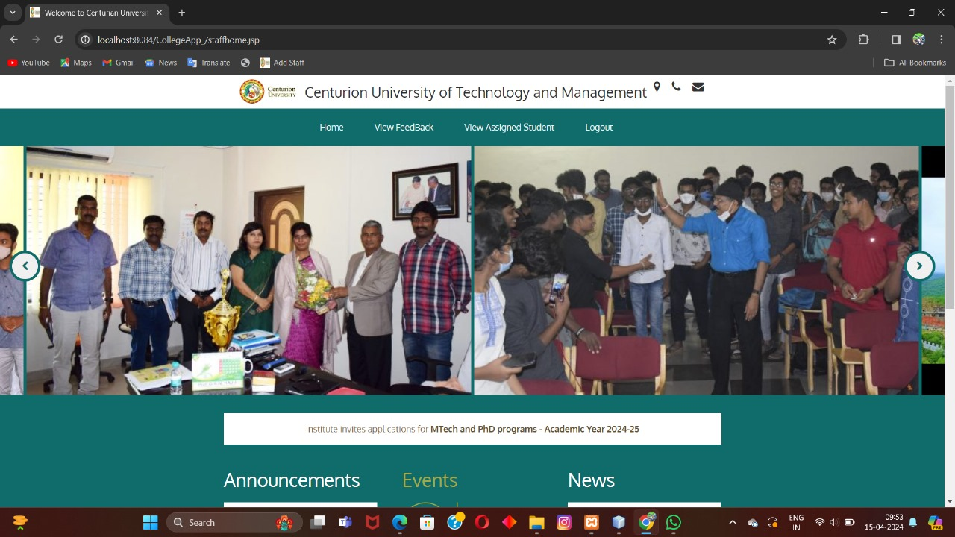
RESULTS OR OUTPUTS
STAFF PAGE
→
→
→
→
→
→
→

Slide 17
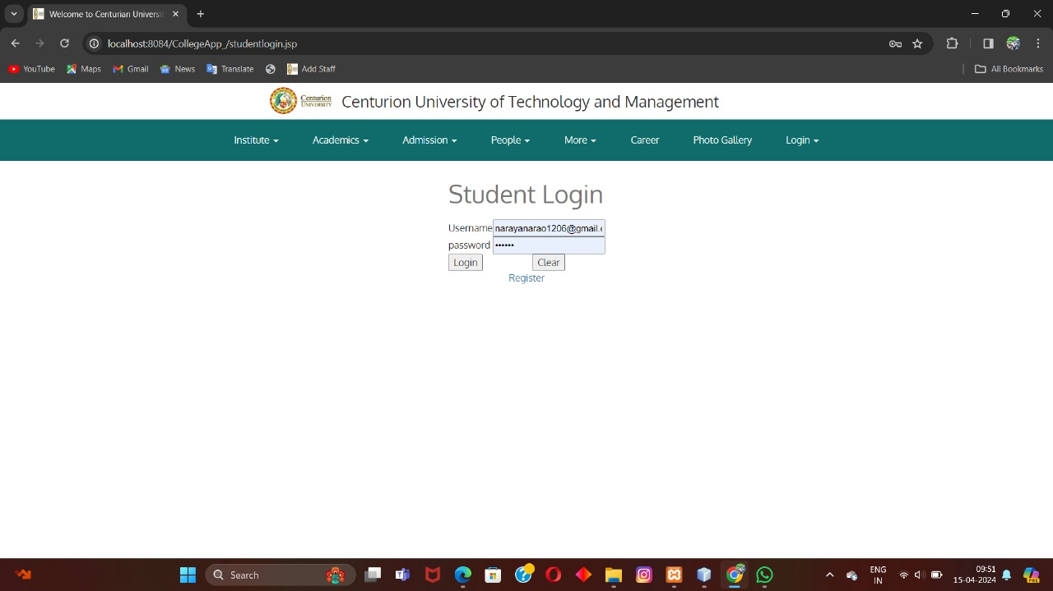

RESULTS OR OUTPUTS
STUDENT PAGE
→
→
→
→
→
→
→

Slide 18




